Slide 1
Quantum Teleportation

Slide 2
Teleportation & Quantum Communication
Teleportation here refers to transferring information from one location to another (not copying)
Since the states of qubits cannot be copied (non-cloning theorem), teleportation is the main approach for passing the state of one qubit to another qubit on the network
In what follows we describe how teleportation is used to solve this problem

Slide 3
Quantum Teleportation
Quantum teleportation, is a protocol where a sender (Alice) transmits a qubit to a receiver (Bob) by making use of a shared entangled quantum state along with two bits of “classical communication”.
The word teleportation usually refers to transportation of solid matter from one place to another using some futuristic communication process, but is used here to refer to refer to information transportation — what is actually teleported is quantum information.

Slide 4
What is Information Teleportation?
Quantum teleportation is a technique to transfer a quantum state
∣ψ⟩=α∣0⟩+β∣1⟩
from one qubit to another, often separated by a large distance.
This process is based on quantum entanglement and classical communication to achieve state transfer without physically moving the qubit.

Slide 5
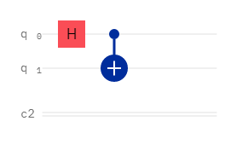
Teleportation is Strongly Based on Entanglement

Slide 6
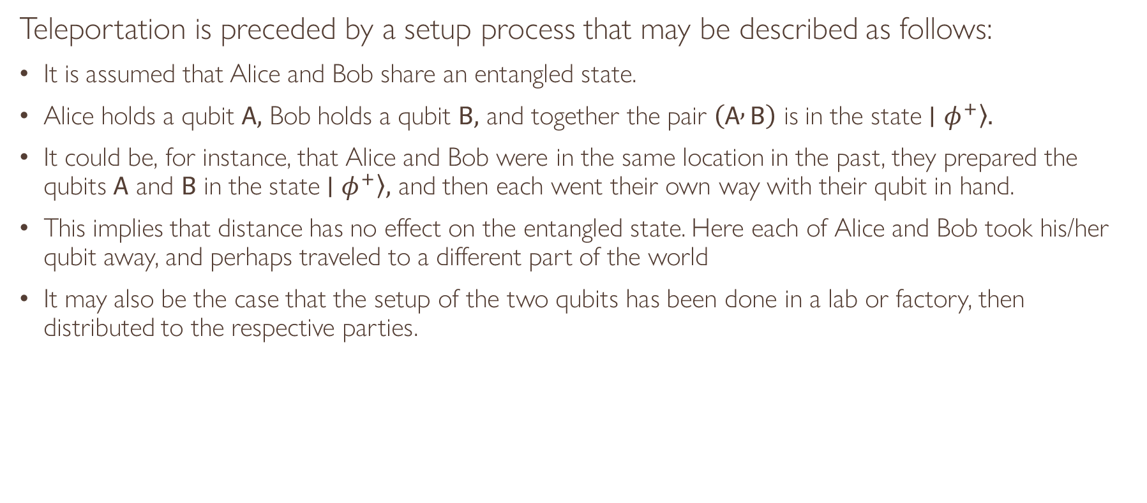
The Setup Process
Teleportation is preceded by a setup process that may be described as follows:
It is assumed that Alice and Bob share an entangled state.
Alice holds a qubit $A,$ Bob holds a qubit $B,$ and together the pair $\left(A , B\right)$ is in the state $\left.∣φ^{+}\right\rangle .$
It could be, for instance, that Alice and Bob were in the same location in the past, they prepared the qubits $A$ and $B$ in the state $\left.∣φ^{+}\right\rangle ,$ and then each went their own way with their qubit in hand.
This implies that distance has no effect on the entangled state. Here each of Alice and Bob took his/her qubit away, and perhaps traveled to a different part of the world
It may also be the case that the setup of the two qubits has been done in a lab or factory, then distributed to the respective parties.

Slide 7
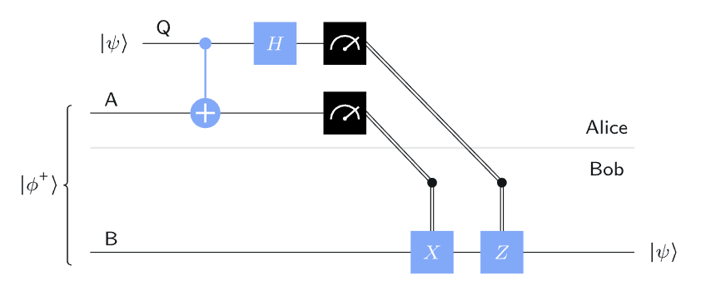
The Teleportation Protocol

Slide 8
Diagram Details
In the above diagram, the Q qubit represents that the state that should be sent to Bob
A is Alice’s qubit, while B is Bob’s qubit, Already entangled, but are now in different locations

Slide 9
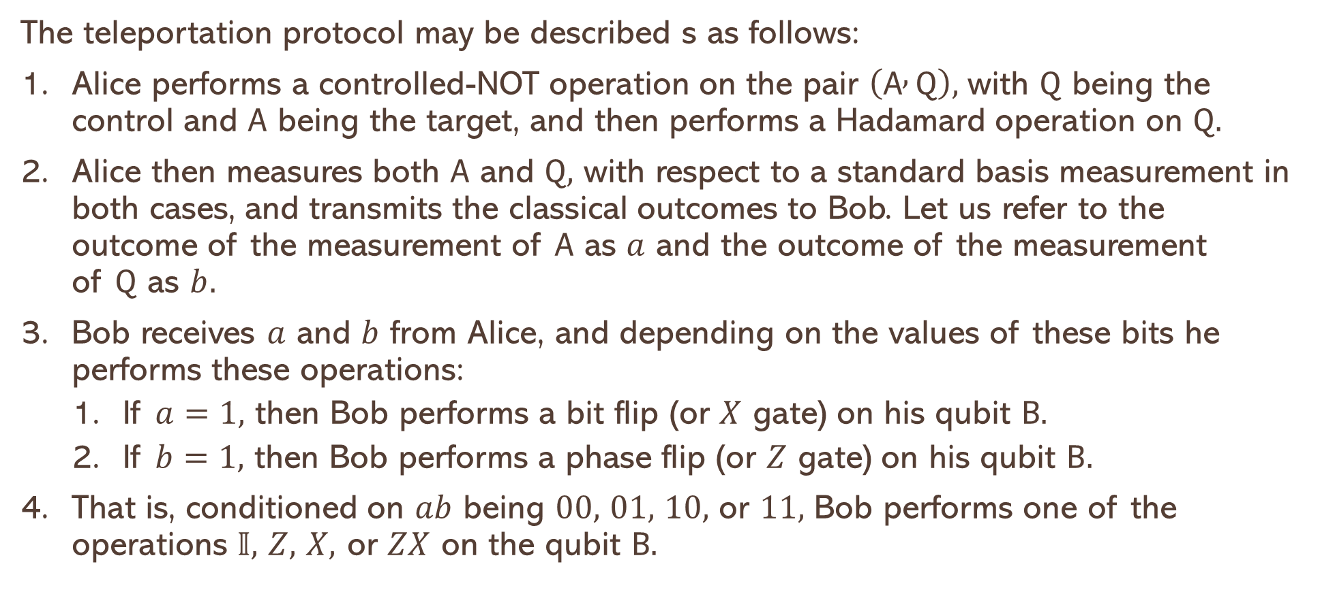
The Protocol
The teleportation protocol may be described s as follows:
Alice performs a controlled-NOT operation on the pair $\left(A , Q\right),$ with $Q$ being the control and $A$ being the target, and then performs a Hadamard operation on $Q.$
Alice then measures both $A$ and $Q,$ with respect to a standard basis measurement in both cases, and transmits the classical outcomes to Bob. Let us refer to the outcome of the measurement of $A$ as $a$ and the outcome of the measurement of $Q$ as $b.$
Bob receives $a$ and $b$ from Alice, and depending on the values of these bits he performs these operations:
If $a=1,$ then Bob performs a bit flip (or $X$ gate) on his qubit $B.$
If $b=1,$ then Bob performs a phase flip (or $Z$ gate) on his qubit $B.$
That is, conditioned on $ab$ being $00,$ $01,$ $10,$ or $11,$ Bob performs one of the operations $𝕀,$ $Z,$ $X,$ or $ZX$ on the qubit $B.$

Slide 10
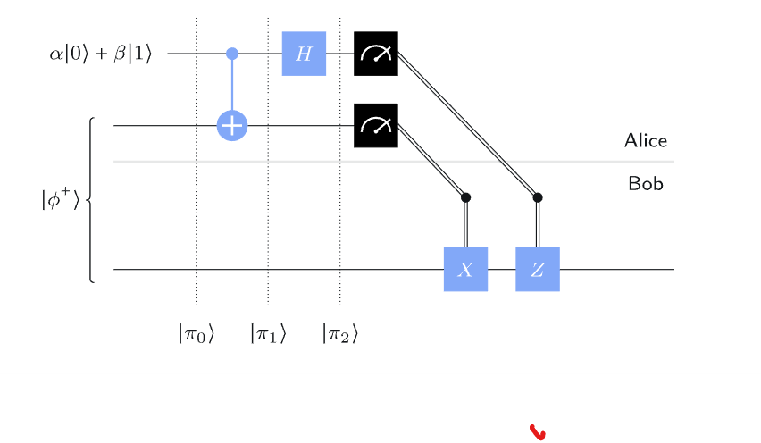
Applying the protocol : A simple Example
The following diagram shows a simple example that applies the protocol

Slide 11
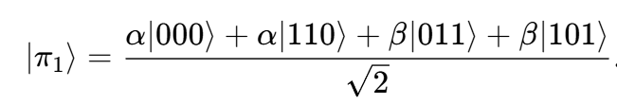
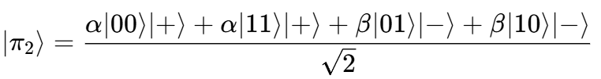
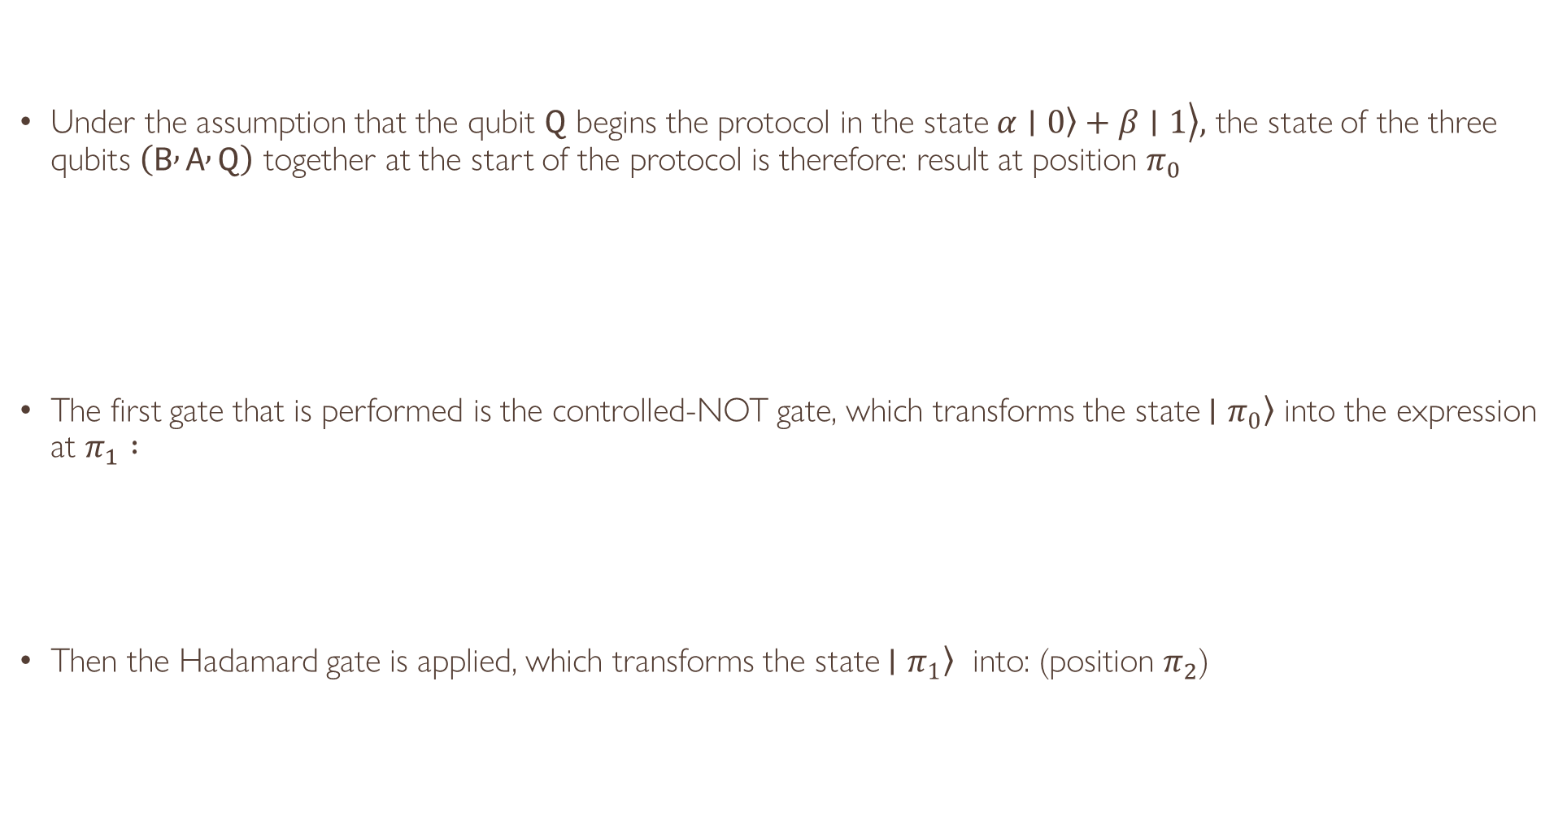
Applying the protocol
Under the assumption that the qubit $Q$ begins the protocol in the state $\left.\left.α∣0\right\rangle +β∣1\right\rangle ,$ the state of the three qubits $\left(B , A , Q\right)$ together at the start of the protocol is therefore: result at position $π_{0}$
The first gate that is performed is the controlled-NOT gate, which transforms the state $\left.∣π_{0}\right\rangle$ into the expression at $π_{1} :$
Then the Hadamard gate is applied, which transforms the state $\left.∣π_{1}\right\rangle$ into: (position $π_{2}$)

Slide 12


Applying the Protocol
Proceeding with above analysis, it will be realized the outcome of the (BAQ) combination is:
Now Bob Applies ZX on the qubit B to get:

